Slide 1
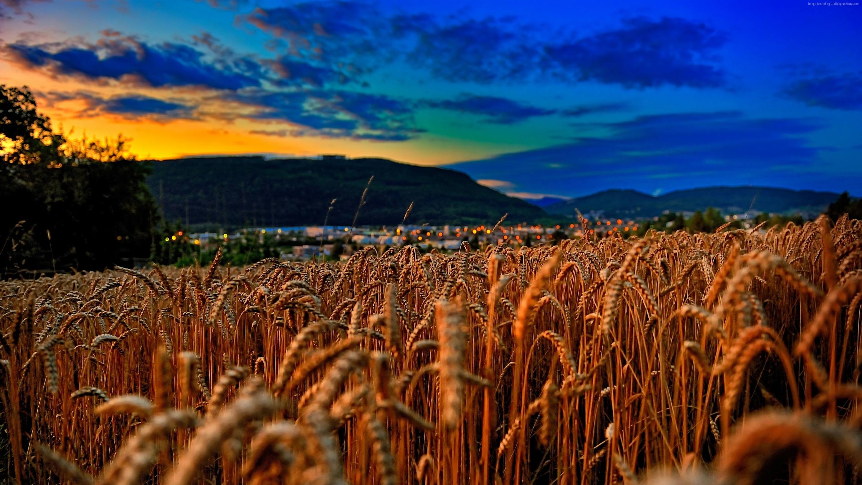
Wheat Assembly in the Ensembl Plants Genome Browser
Wheat as a model organism workshop
Guy Naamati, Dan Bolser Dec 6th 2016

Slide 2
Objectives
How to navigate the Ensembl Genomes (Ensembl Plants) browser website
Compare genes and regions within and between species
Find wheat orthologues and homeologues

Slide 3
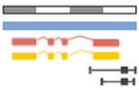
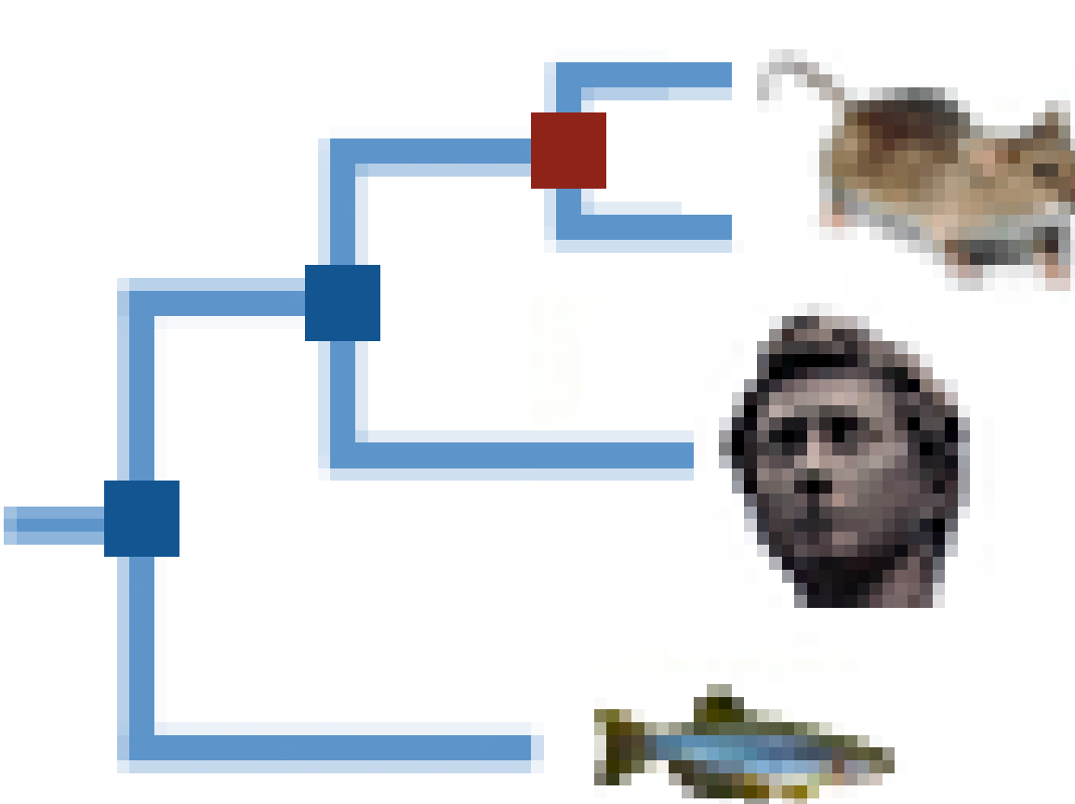


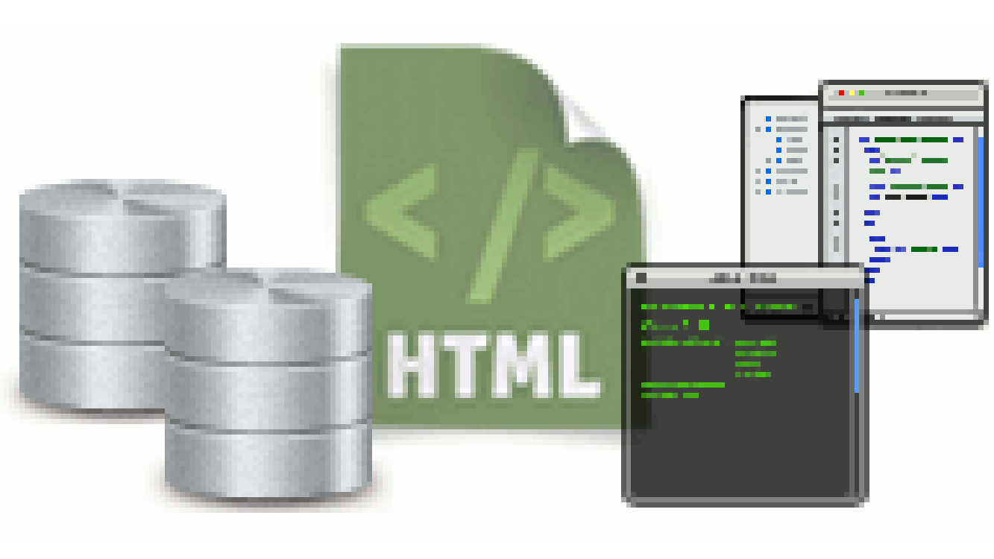
Ensembl Plants Features
Genes for 44 genomes
Gene trees
Variation display and VEP
Display of user data
BioMart (advanced query and data export)
Programmatic access via the APIs
Completely Open Source

Slide 4





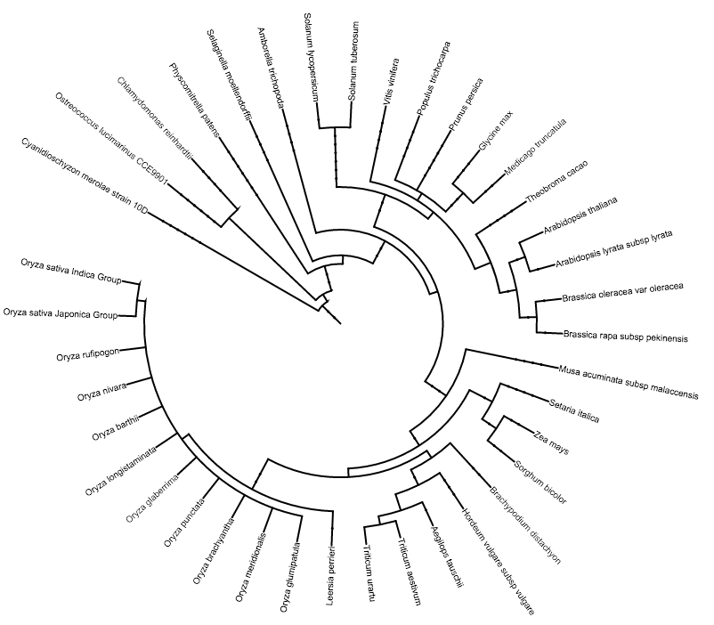


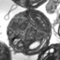
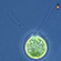



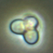







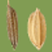
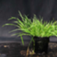

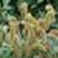
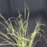
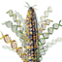
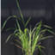
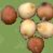

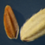


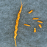


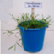
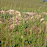


Ensembl Plants species

Slide 5
Ensembl and Ensembl Genomes
 | Ensembl | EnsemblGenomes
Initiated | 2000 | 2009
Species | Vertebrates (fly, worm and yeast as outgroups) | Non-vertebrates (protists, plants, fungi, metazoa, bacteria)
Annotation | by Ensembl | in collaboration with the scientific communities
URL | www.ensembl.org | www.ensemblgenomes.org

Slide 6

Release cycle
34
Dec 2016
New/updated interfaces
New genome assemblies
Updated variation data
3-4 months
Underlying software updates
Comparative analysis on new genes and genomes
Updated gene sets

Slide 7
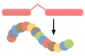
Genes and Transcripts

Slide 8
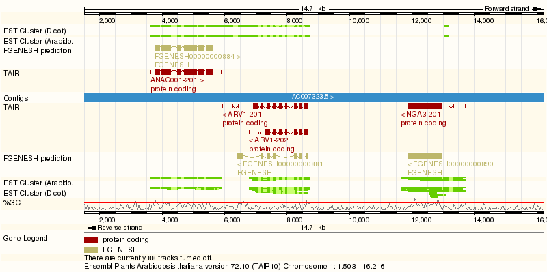
Gene views
Non-coding exon
Coding exon
Intron
Genes from different sources shown in different tracks and colours

Slide 9
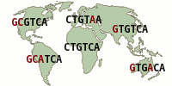
Variation

Slide 10
Variation sources - Cereals DB
Axiom 820K SNP Array: 504,092 markers mapped uniquely with 100% identity
Axiom 35K SNP Array: 21,423 mapped
35K markers include genotype data from 590 samples
KASP: 486 markers with 169 samples (December pre-site)

Slide 11
Variation sources - EMS
2.8 million Kronos projected markers
4.6 million Cadenza projected markers
Available in December presite

Slide 12
Comparative Genomics

Slide 13
Applications of Comparative Genomics
Comparative genomics allows us to understand:
evolution
differences between species at the genome level
gene function based on homology
the distribution of highly conserved regions

Slide 14
Comparative analysis by taxa
Ensembl
Plants Compara

Slide 15
Gene trees
all-vs-all blastp + hcluster_sg
Based on protein alignments
Representative protein of each Ensembl gene
Clustering, Blast, multiple alignments
Reconciliation with species tree
Orthologue/Paralogue inference
http://www.ensembl.org/info/docs/compara/homology_method.html
Orthologues and Paralogues

Slide 16

Homology relationships
Paralogues
Genes emerged through a duplication event
eg
w1 and w2
b1 and b2
Orthologues
Genes emerged through a speciation event
eg
w1 and b1
b2 and g
w2 and g
w1
b1
w2
b2
g
One-to-one
- Speciation
One-to-many
-Speciation followed by Duplication
One-to-one
One-to-many
Speciation
Duplication

Slide 17
Homoeologues
Hybridisation
Like paralogues, since they’re all found in the same species
Like orthologues, since they arose through speciation events
Speciation
Duplication

Slide 18
Whole genome alignments
To identify highly conserved regions
sequences that evolve slowly
regions likely to be functional
both coding and non-coding sequences
For wheat components we aligned coding regions

Slide 19
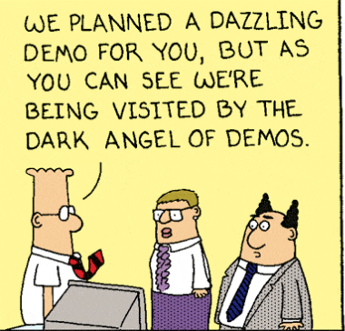
Live Demo

Slide 20
Thanks for listening!
gnaamati@ebi.ac.uk
dbolser@ebi.ac.uk
http://pre-test.plants.ensembl.org/index.html
For general questions
helpdesk@ensemblgenomes.org

